Slide 1
Lecture 5: GPUs and supercomputers
Practical deep learning

Slide 2
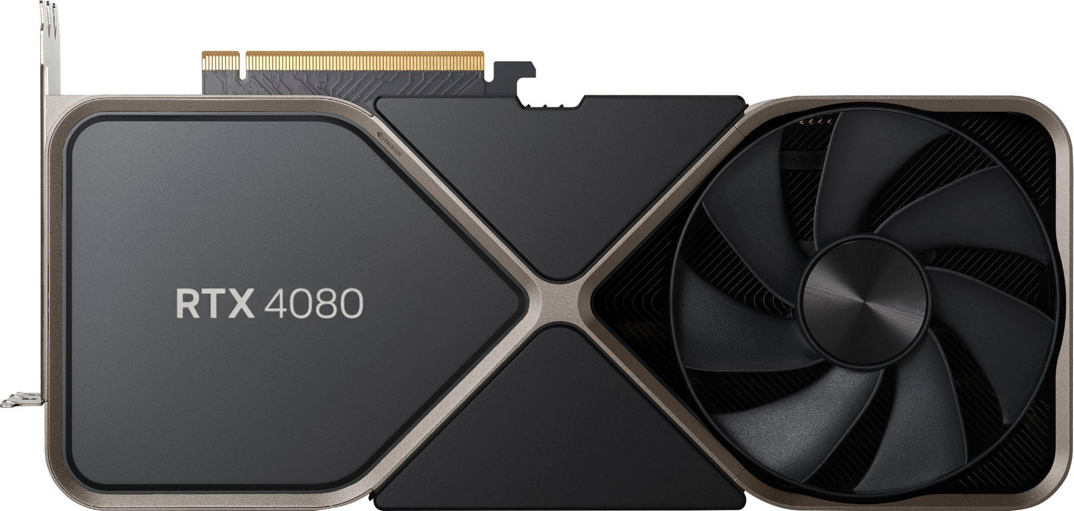

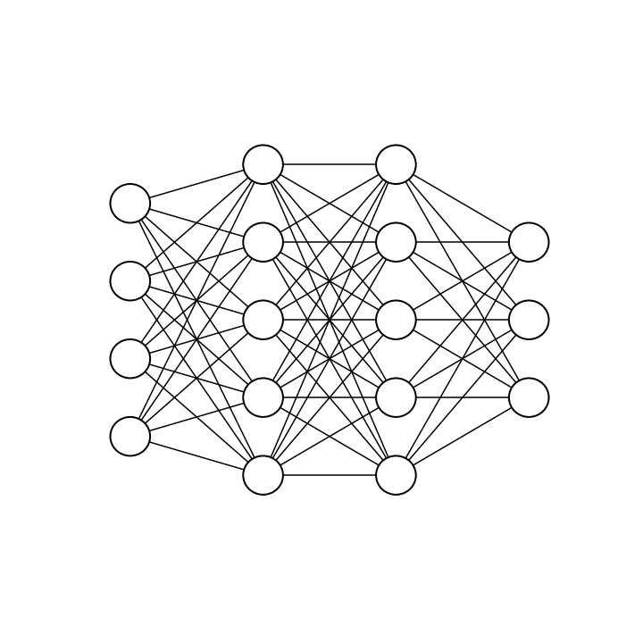
GPU computing
GPU = graphics processing unit
Initially for 3D computer games
transforming points in 3D space requires doing many simple calculations in parallel
neural network calculations are mathematically very similar

Slide 3
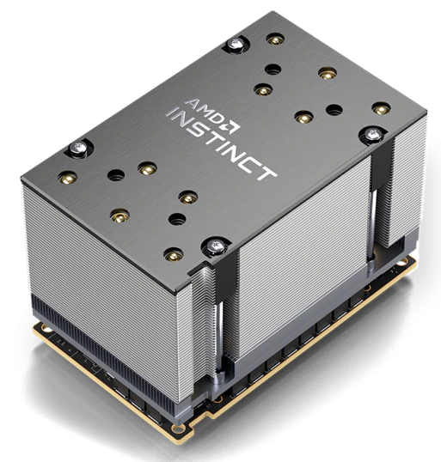
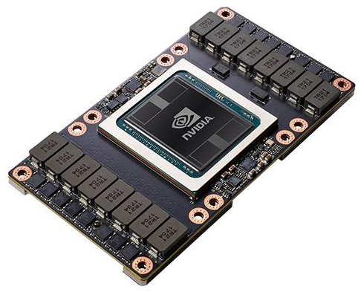
GPU computing
CPUs are optimized for latency whereas GPUs are optimized for throughput
That is a CPU calculates one thing very fast
GPU calculates many things simultaneously (a bit slower)
Example: CSC’s Puhti GPU nodes with V100’s:
 | #cores | max clock speed | memory
2 x Xeon CPUs | 2 x 20 | 3.9 GHz | 384 GB
4 x V100 GPUs | 4 x 5120 | 1.455 GHz | 4 x 32 GB

Slide 4
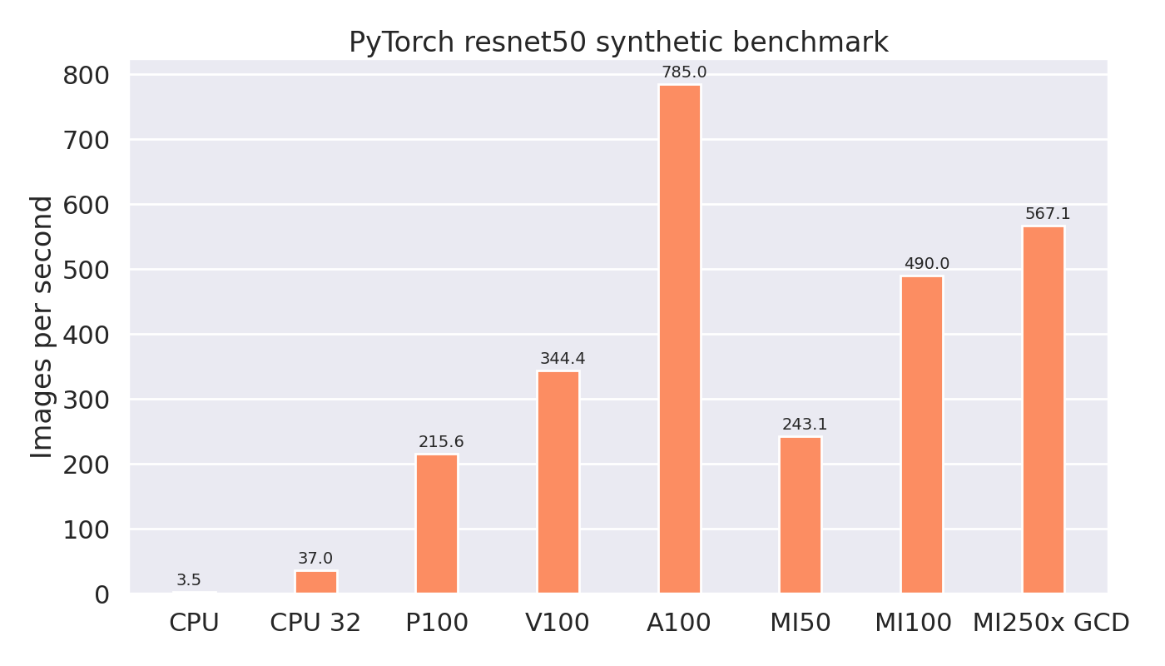

Slide 5
CSC computing resources

Slide 6

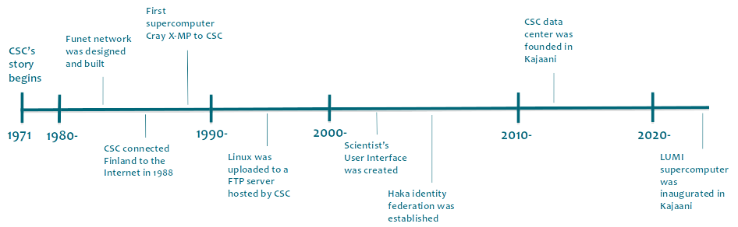
CSC - IT Center for Science Ltd.
Finnish non-profit state enterprise with special tasks
Owned by the Finnish state (70%) and higher education institutions (30%)
ICT expertise for research, education, public administration
Headquarters in Espoo, datacenter in Kajaani

Slide 7
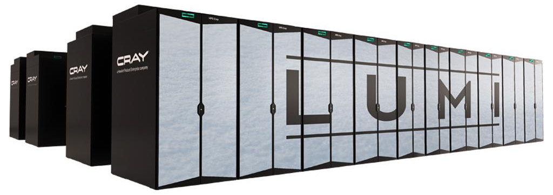
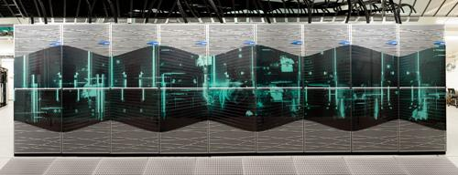
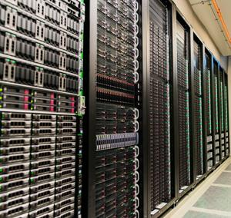



CSC’s computing infrastructure
LUMI
11,912 GPUs AMD MI250X
Mahti
96 GPUs NVIDIA A100
Puhti
320 GPUs NVIDIA V100
cPouta VMs
Allas object storage
Rahti containers
ePouta private VMs
Notes:
FAIR data services, under discussion for research institutes
‹#›

Slide 8
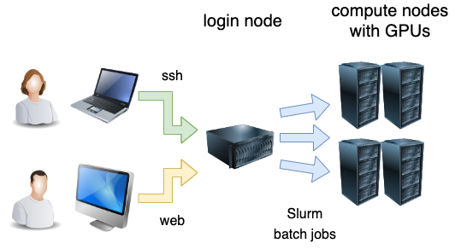
What is a supercomputer?
HPC = high-performance computing
A large number (cluster) of “normal” computers (nodes)
Actually pretty good computers: >100 GB RAM, 10s-100s CPU cores
Sometimes also GPUs
Supercomputer = 100s or 1000s of such computers connected with
Shared file system
Fast network (100-200 GB/s)
Queuing system for batch jobs
Dividing a heavy computation into smaller subtasks = parallelism

Slide 9
Puhti AI
V100 nodes consisting of 80 servers with:
2x Xeon Gold 6230 Cascade Lake CPUs with 20 cores each running at 2.1 GHz
CPUs support VNNI instructions
384 GB memory
4x NVIDIA V100 GPUs with 32 GB memory each, connected with NVLink
3,6 TB fast local NVMe storage
Dual-rail HDR100 InfiniBand 200 interconnect network connectivity, providing 200 Gbps of aggregate bandwidth

Slide 10
Mahti AI
A100 nodes consisting of 24 servers with:
2x AMD Rome 7H12 CPUs with 64 cores each running at 2.6 GHz
512 GB memory
4x NVIDIA A100 GPUs with 40 GB memory each, connected with NVLink
3,8 TB fast local NVMe storage
HDR InfiniBand interconnect network connectivity, providing 200 Gbps of aggregate bandwidth

Slide 11
LUMI
HPE Cray EX Supercomputer
LUMI-C (CPU) nodes consisting of 2048 servers with:
2x 64-core AMD EPYC “Milan” CPU
Between 256 GB and 1024 GB RAM
HPE Slingshot-11 interconnect
LUMI-G (GPU) nodes consisting of 2978 servers with:
64-core AMD EPYC “Trento” CPU, 512 GB RAM
4x AMD MI250X GPUs, each with 128 GB HBM2e memory
MI250X consists of two compute dies → 8 GCDs per node
each MI250X GCD has 64 GB VRAM
4x 200 Gbit/s HPE Slingshot-11 interconnects

Slide 12

LUMI - a European supercomputer
LUMI consortium countries: Finland, Belgium, the Czech Republic, Denmark, Estonia, Iceland, the Netherlands, Norway, Poland, Sweden, and Switzerland
Hosted by CSC in Kajaani
LUMI User Support main support channel
Science support from local organizations
Resource allocation:
50% EuroHPC JU
each consortium country according to contribution
up to 20% industry and SMEs

Slide 13
Running batch jobs on CSC supercomputers

Slide 14
Compute nodes are used via a queuing system
Do not use the login node for heavy computation!

Slide 15
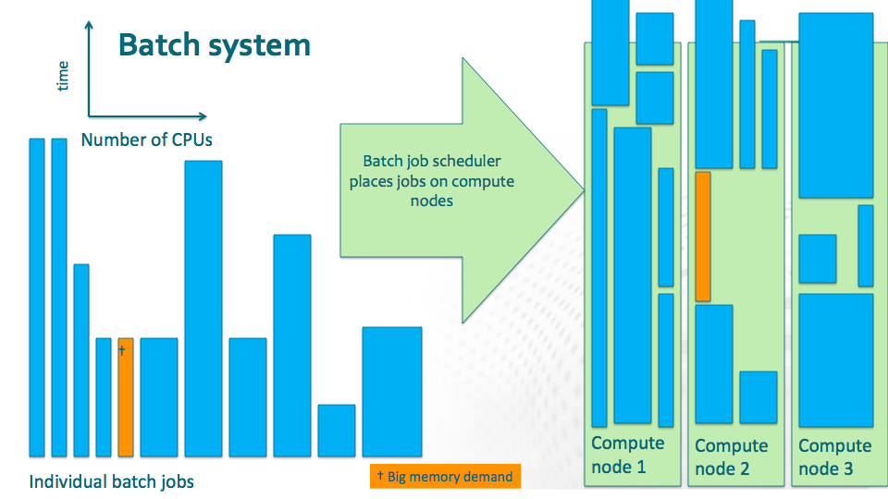

Slide 16
Batch jobs
Steps for running a batch job:
Write a batch job script
Make sure you have all the input files where the program can find them
Submit your job (sbatch batch_job_file.sh)
Wait, or monitor queue (squeue -u $USER)
Look at the results files (less slurm-jobid.out)
You have to specify the necessary resources:
resources need to be sufficient for the job
requested resources consume BUs and affect time spent in queue ⇒ realistic resource requests give best results

Slide 17
Example GPU batch job script on LUMI
#!/bin/bash
#SBATCH --account=<project>
#SBATCH --partition=small-g
#SBATCH --gpus-per-node=1
#SBATCH --cpus-per-task=7
#SBATCH --mem=60G
#SBATCH --time=1:00:00
python my_python_program.py

Slide 18
Example batch job script on Puhti
#!/bin/bash
#SBATCH --partition=gpu
#SBATCH --gres=gpu:v100:1
#SBATCH --time=1:00:00
#SBATCH --mem=32G
#SBATCH --cpus-per-task=10
#SBATCH --account=<project>
python my_python_program.py

Slide 19
Relevant sbatch options
-J, --job-name name of job -c, --cpus-per-task number of processors per task -p partition specify partition --gpus-per-node number of GPUs per node (note: use --gres instead on Puhti, Mahti) -t, --time time limit in DD-HH:MM:SS --mem the real (host) memory required per node -o, --output file for script’s standard output -e, --error file for script’s standard error
-A, --account project name

Slide 20
Managing batch jobs
sbatch batch_job_file.sh submit a job sbatch --options batch_job_file.sh submit job and add or modify option
scancel jobid delete a job
squeue -l show all jobs (long format) squeue -l --me show all jobs for current user (me)
squeue -l -j jobid show status of a single job
sinfo check all available queues

Slide 21
Module system
Different software packages have different, possibly conflicting, requirements
Most commonly used module commands:
module help Show available options
module load modulename Load the given environment module module load modulename/version
module list List the loaded modules
module avail List modules that are available to load
module spider List all existing modules
module spider name Search the list of existing modules
module use path Make available modules from path
module unload modulename Unload the given environment module
module purge Unload all modules

Slide 22
Using PyTorch on LUMI
LUST documentation
Can be installed by yourself: PyTorch officially supports AMD
Install via container, e.g., AMD provided Docker containers: https://hub.docker.com/u/rocm
CSC provided modules for PyTorch, TensorFlow and JAX:
module use /appl/local/csc/modulefiles/ # activate CSC modules
module avail pytorch # show available pytorch versions
module load pytorch # loads current default version
module load pytorch/2.1 # loads specific version

Slide 23
Storage on HPC clusters
Shared storage (Lustre):
shared between all computers in the cluster (/scratch, /projappl)
your home directory is located here as well (/users)
slow when accessing huge number of files!
Flash on LUMI:
High performance temporary storage
Also shared storage (Lustre)
Temporary storage on compute nodes:
/tmp resides in memory (ramdisk), included in memory allocation
available only to the running job, purged after running

Slide 24
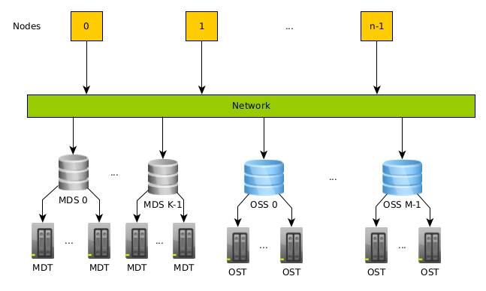
Don’t read lots of small files from shared disk
Shared file system (Lustre) separates actual data and metadata (file info, including on which file server the file is stored)
Optimized for parallel I/O of large files
Bad for small files and intensive metadata operations
For example Puhti has:
4 MDTs
24 OSTs
~760 compute nodes

Slide 25
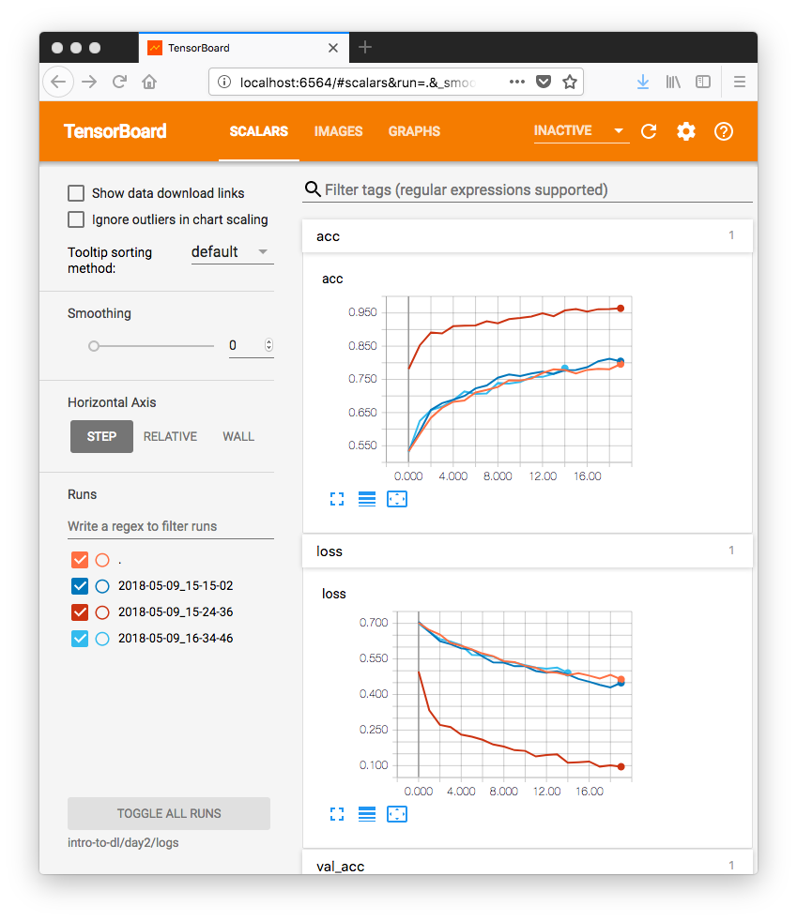
Visualizing results: TensorBoard
Tool to visualize graphs, plot quantitative metrics, and show additional data like images
Operates by reading TF event files, which contain summary data that can be generated while running your code
Instructions in the exercises if you want to try

Slide 26
Visualizing results: Other options
MLflow (https://mlflow.org/ )
Weights & Biases (https://wandb.ai/)

